Slide 1
Electronic Devices
Mid Term Lecture - 09
Faculty Name: Dr. Mohammad Alif Arman
Email : dr.alifarman@aiub.edu
Room: DN0526
Reference book:
Electronic Devices and Circuit Theory (Chapter-4)
Robert L. Boylestad and L. Nashelsky , (11th Edition)

Slide 2
Objectives
Be able to determine the dc levels for the variety of important BJT configurations.
Understand how to measure the important voltage levels of a BJT transistor configuration and use them to determine whether the network is operating properly.
Become aware of the saturation and cutoff conditions of a BJT network and the expected voltage and current levels established by each condition.
Be able to perform a load-line analysis of the most common BJT configurations.
Become acquainted with the design process for BJT amplifiers.
Understand the basic operation of transistor switching networks.
Begin to understand the troubleshooting process as applied to BJT configurations.
Develop a sense for the stability factors of a BJT configuration and how they affect its operation due to changes in specific characteristics and environmental changes.

Slide 3
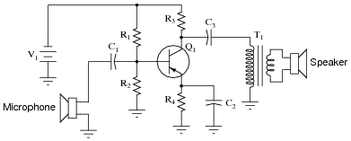
BIASING
Applying DC voltages to the transistor to turn it on so that it can amplify AC signal.
Once the desired DC current and voltage levels have been defined, a network must be constructed that will establish the desired operating point.

Slide 4
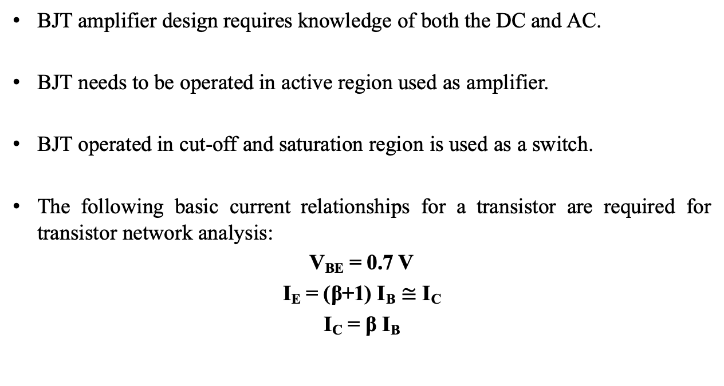
INTRODUCTION
BJT amplifier design requires knowledge of both the DC and AC.
BJT needs to be operated in active region used as amplifier.
BJT operated in cut-off and saturation region is used as a switch.
The following basic current relationships for a transistor are required for transistor network analysis:
V_{BE} = 0.7 V
I_{E} = (β+1) I_{B} $≅$ I_{C}
I_{C} = β I_{B}

Slide 5
INTRODUCTION
Biasing:
Applying DC voltages to establish a fixed level of current and voltage.
The applied DC establishes an operating point (Q-point) that define the region for the signal amplification.
For a BJT to be biased in active operating region, the following must be true:
BE junction = forward biased
BC junction = reverse biased

Slide 6
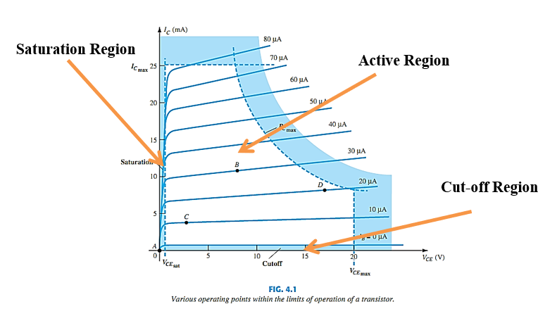
BIASING AND THE 3 STATES OF OPERATION

Slide 7
OPERATING POINT (Q-POINT)
Operating Point: Quiescent point or Q-point (static point)
The biasing circuit can be designed to set the device operation at any of these points or others within the active region.
The BJT device could be biased to operate outside the max limits, but the result of such operation would be shortening of the lifetime of the device or destruction of the device.
The chosen Q-point often depends on the intended use of the circuit.

Slide 8
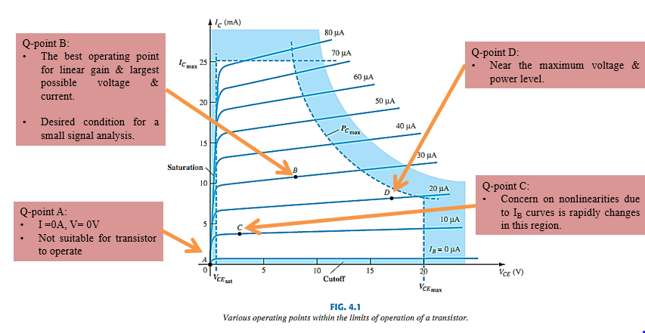
VARIOUS Q-POINTS WITHIN THE LIMITS OF OPERATION

Slide 9
BJT BIAS CONFIGURATIONS
Fixed-Bias Configuration
Emitter-Bias Configuration
Voltage-Divider Bias Configuration
Collector Feedback Configuration

Slide 10
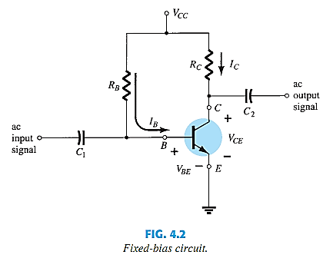
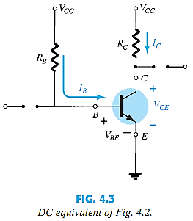
FIXED-BIAS CONFIGURATION

Slide 11
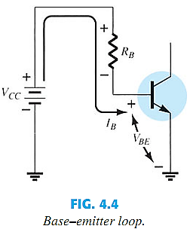


FORWARD BIAS OF BASE–EMITTER

Slide 12
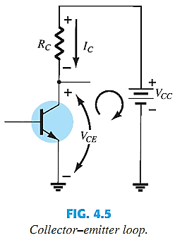






COLLECTOR–EMITTER LOOP

Slide 13
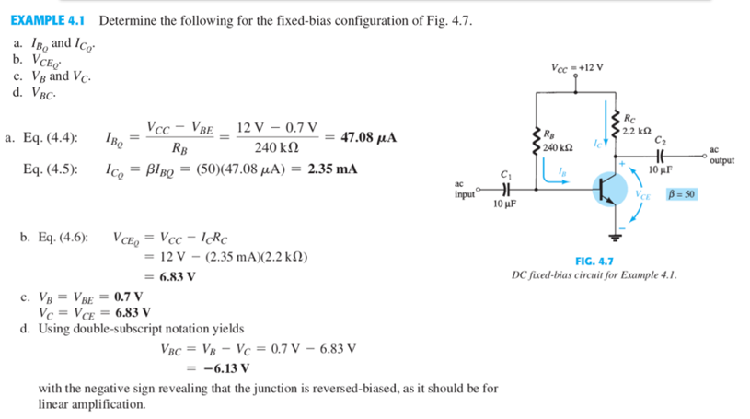
FIXED-BIAS CONFIGURATION EXAMPLE

Slide 14
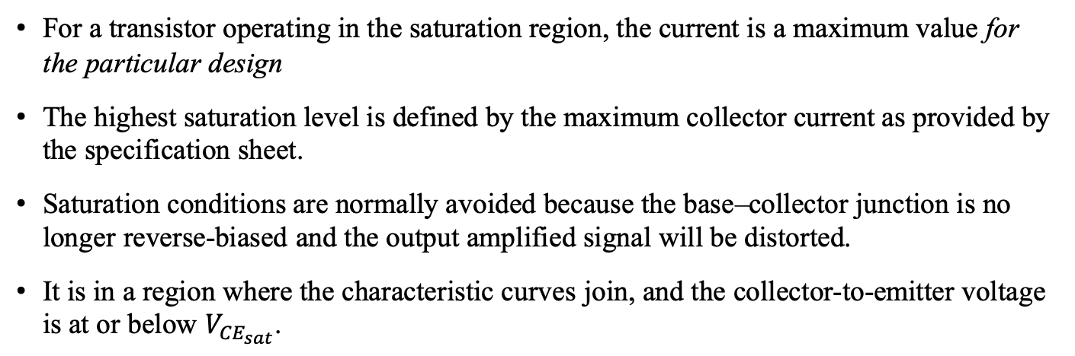
Transistor Saturation
For a transistor operating in the saturation region, the current is a maximum value for the particular design
The highest saturation level is defined by the maximum collector current as provided by the specification sheet.
Saturation conditions are normally avoided because the base–collector junction is no longer reverse-biased and the output amplified signal will be distorted.
It is in a region where the characteristic curves join, and the collector-to-emitter voltage is at or below $V_{{CE}_{sat}}$.
The resulting saturation current for the fixed-bias configuration is
See Example 4.2

Slide 15
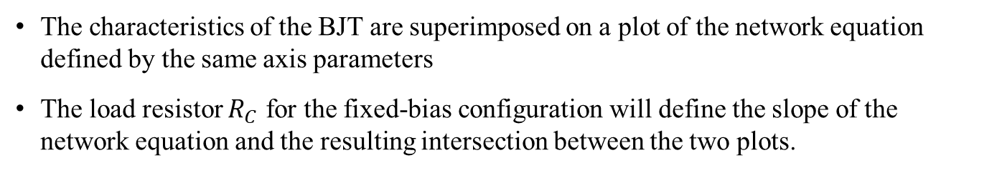
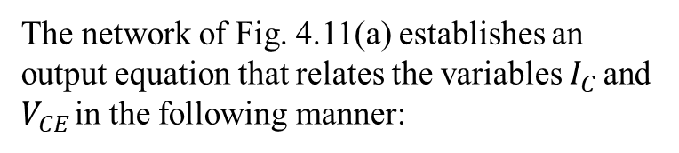
Load-Line Analysis
The characteristics of the BJT are superimposed on a plot of the network equation defined by the same axis parameters
The load resistor $R_{C}$ for the fixed-bias configuration will define the slope of the network equation and the resulting intersection between the two plots.
The network of Fig. 4.11(a) establishes an output equation that relates the variables $I_{C}$ and $V_{CE}$ in the following manner:

Slide 16
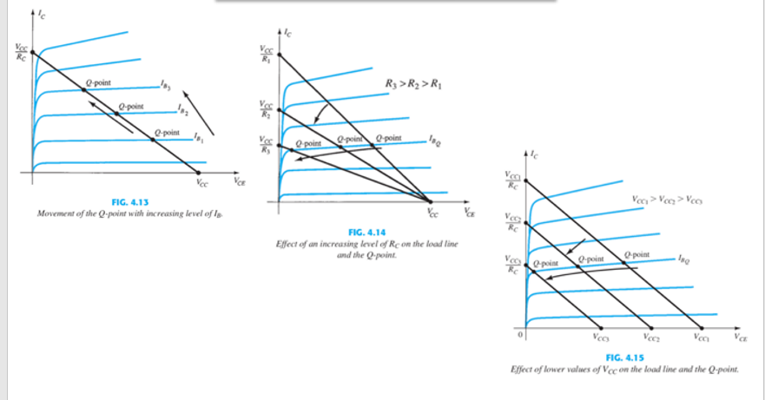
Load-Line Analysis

Slide 17
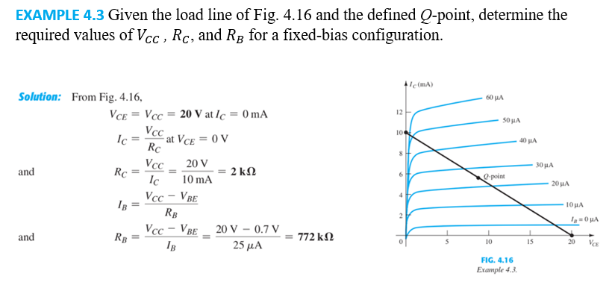
EXAMPLE

Slide 18
Thank You

